Slide 1
Project on predicting used car prices
Presented by Sanu Mathew

Slide 2
Introduction
The used car market has grown rapidly over the past decade, driven by increasing consumer demand, digital marketplaces, and improved vehicle longevity. Unlike new cars, used vehicles exhibit significant price variation influenced by multiple factors such as vehicle age, mileage, brand reputation, fuel type, ownership history, and overall condition. This inherent complexity makes accurate price estimation a challenging yet valuable problem for both buyers and sellers.
Incorrect pricing can lead to substantial economic consequences. Overpricing reduces sales probability and increases inventory holding costs for dealers, while underpricing results in financial losses for sellers. Consequently, developing a reliable, data-driven pricing model is critical for enabling fair transactions, improving market efficiency, and supporting decision-making within automotive marketplaces.
This project focuses on building a machine learning-based regression model to predict used car prices using historical vehicle data. By analyzing relationships between vehicle attributes and market prices, the model aims to capture hidden patterns that traditional rule-based valuation methods may fail to identify. The study leverages statistical analysis, feature engineering, and multiple predictive algorithms to enhance price estimation accuracy.
Key objectives of the project include:
• Understanding the primary drivers of used car prices • Handling real-world data quality issues and inconsistencies • Engineering meaningful features reflecting vehicle usage and depreciation • Comparing multiple machine learning models for optimal performance • Evaluating prediction accuracy using standard regression metrics
Through this approach, the project demonstrates how machine learning techniques can transform raw automotive data into actionable pricing insights, offering practical benefits for dealerships, online platforms, and consumers alike.

Slide 3
Problem statement
The used car market is highly dynamic, with vehicle prices influenced by numerous interacting factors including age, mileage, brand perception, fuel type, ownership history, and condition indicators. Traditional pricing approaches often rely on heuristic rules, subjective judgment, or static depreciation tables, which fail to capture real-world market behavior and lead to inconsistent valuations.
This pricing inefficiency creates tangible business risks. Dealers may experience prolonged inventory cycles due to overpricing, while sellers risk revenue loss from underpricing. Buyers also face uncertainty regarding fair market value. Given the scale and variability of listings in digital automotive platforms, there is a clear need for an automated, data-driven pricing mechanism that can generate accurate and consistent price estimates.
The core problem addressed in this project is:
How can machine learning techniques be used to predict used car prices accurately by leveraging vehicle attributes and market data?
Business Objective
The objective of this project is to design and implement a predictive pricing model that supports reliable used car valuation and improves decision-making across automotive marketplaces and dealerships.
From a business perspective, the model aims to:
• Enable consistent and data-backed vehicle price estimation • Reduce pricing errors and associated revenue leakage • Improve inventory turnover through realistic pricing • Assist buyers and sellers in fair value assessment • Support scalable valuation for large listing volumes
Ultimately, the solution seeks to replace subjective pricing practices with an analytical framework capable of adapting to market patterns.

Slide 4
METHODOLOGY
The project follows a structured, industry-aligned analytical workflow designed to transform raw automotive data into a deployable predictive model
1. Data Understanding & Exploration
Initial analysis focused on understanding dataset characteristics, feature distributions, and relationships with the target variable (Price). Statistical summaries and visual diagnostics were used to detect skewness, anomalies, and behavioural patterns.
2. Data Quality & Preprocessing
Real-world inconsistencies were addressed through systematic cleaning steps:
• Standardizing categorical labels (e.g., Manual vs MANUAL) • Handling missing values using appropriate imputation strategies • Resolving category duplication and noise • Identifying and managing extreme price outliers • Transforming skewed variables (log transformations)
These steps ensured model stability and improved learning behaviour.
3. Feature Engineering
Domain-relevant features were created to better represent vehicle usage and depreciation effects:
• CarAge derived from ModelYear • UsageIntensity / KM_per_Year indicators • WearAndTear proxies • HighMileageFlag segmentation • Premium brand identification
Feature engineering significantly enhanced predictive signal strength.

Slide 5
4. Model Development
Multiple regression algorithms were evaluated to identify the best predictive approach:
• Linear Regression & Regularized Models • Support Vector Regression (SVR) • Tree-based Models • Ensemble Methods (Gradient Boosting, Random Forest) • XGBoost
Models were implemented using pipelines to ensure reproducibility and prevent data leakage.
5. Model Evaluation & Selection
Performance was measured using industry-standard regression metrics:
• Mean Absolute Error (MAE) • Mean Squared Error (MSE) • R² Score
Cross-validation was applied to assess generalization capability and robustness.
6. Validation & Diagnostics
Residual analysis and prediction diagnostics were conducted to verify model behaviour, bias patterns, and error distribution characteristics.

Slide 6
Dataset information
The dataset used in this project consists of structured used-car listing data collected from an online automotive marketplace. Each record represents an individual vehicle listing along with its associated attributes and price.
Dataset Size
Total Observations: 1,064 vehicle listings
Total Features: Multiple numerical and categorical variables
Target Variable: Price (expressed in Lakhs)
The dataset size is sufficient for supervised regression modelling and allows meaningful pattern extraction across brands, vehicle types, and usage characteristics.
Feature Categories
The variables in the dataset can be broadly classified into numerical, categorical, and engineered features.
1. Numerical Features
These variables capture measurable vehicle characteristics:
Kilometer → Total distance driven
ModelYear → Manufacturing / registration year
Warranty → Binary warranty indicator
QualityScore → Vehicle condition proxy
CarAge → Derived vehicle age
KM_per_Year / UsageIntensity → Usage behaviour indicators
These features directly influence depreciation and pricing dynamics.

Slide 7
2. Categorical Features
Categorical variables describe vehicle identity and market segmentation:
Company → Manufacturer / brand
Model → Vehicle model name
FuelType → Petrol / Diesel / CNG / etc.
BodyStyle → Hatchback / Sedan / SUV / etc.
TransmissionType → Manual / Automatic
Owner → Ownership history
DealerState → Geographic location
Colour → Vehicle colour
These features capture brand positioning, consumer preference, and regional effects.
3. Engineered Features
Additional variables were derived to improve predictive power and represent domain behaviour:
CarAge → Age-based depreciation effect
UsageIntensity → Normalized mileage usage
WearAndTear → Composite condition proxy
HighMileageFlag → Segmentation variable
IsPremiumBrand → Brand tier indicator
WarrantyImpact → Warranty-related pricing signal
Feature engineering enhanced model performance by incorporating practical automotive valuation logic.

Slide 8
Data Characteristics
Several real-world data challenges were observed:
Right-skewed price distribution (presence of premium vehicles)
Category duplication & label inconsistency
Missing values, especially in TransmissionType
Outliers, typical of luxury / high-end vehicles
Imbalanced category frequencies
These issues were systematically addressed during preprocessing to ensure modelling reliability.
Target Variable
Variable: Price
Unit: Lakhs
Distribution: Positively skewed
Transformation Applied: log1p(Price) for model stability
Log transformation reduced skewness and improved regression behaviour.

Slide 9
Dataset description
 | Id | Kilometer | ModelYear | Warranty | QualityScore
count | 1064.000000 | 1064.000000 | 1064.000000 | 1064.000000 | 1064.000000
mean | 568156.542293 | 52807.187970 | 2016.864662 | 0.738722 | 7.770207
std | 16438.139974 | 33840.296979 | 2.996786 | 0.439538 | 0.719717
min | 525978.000000 | 101.000000 | 2003.000000 | 0.000000 | 0.000000
25% | 555321.500000 | 32113.500000 | 2015.000000 | 0.000000 | 7.500000
50% | 572753.000000 | 49432.000000 | 2017.000000 | 1.000000 | 7.800000
75% | 583072.750000 | 68828.500000 | 2019.000000 | 1.000000 | 8.100000
max | 589122.000000 | 640000.000000 | 2023.000000 | 1.000000 | 9.400000
Observations:
1) 1064 records → good sample size for analysis / ML
2) Price Distribution - Mean: 8.36 Lakhs, Median: 6.75 Lakhs, Max: 85 Lakhs, Std Dev: 5.72 (very large) Strong right skew present Mean > Median → expensive cars pulling average up High variance → harder regression problem Justifies log transform

Slide 10
3) Kilometer - Mean: 52,768 km, Median: 49,413 km (close), Max: 640,000 km (!!), Std Dev: 33,832 Still heavy-tailed even after capping Presence of extreme usage vehicles Potential non-linear price decay Supports tree models / non-linear learners Median ≈ Mean → Most cars reasonably driven Few extreme cases distort variance
4) Warranty - Mean ≈ 0.74, Median = 1, Binary distribution (0 / 1) Majority vehicles under warranty Warranty strongly associated with higher prices Likely correlated with ModelYear Adds buyer confidence signal
5) QualityScore - Mean ≈ 7.77, Median ≈ 7.80, Range = 0 → 9.4, Std Dev ≈ 0.72 Min = 0 is suspicious Most scores between 7.5 – 8.1 Zero likely data anomaly / missing encoding

Slide 11
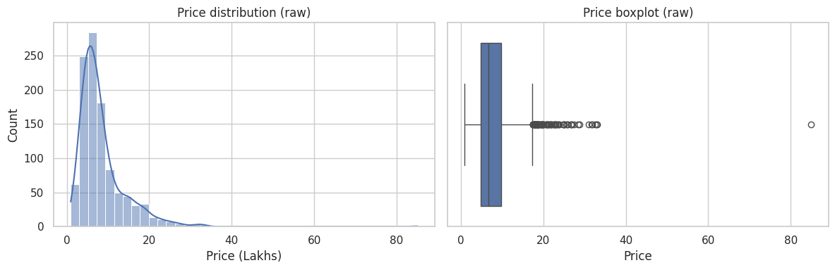
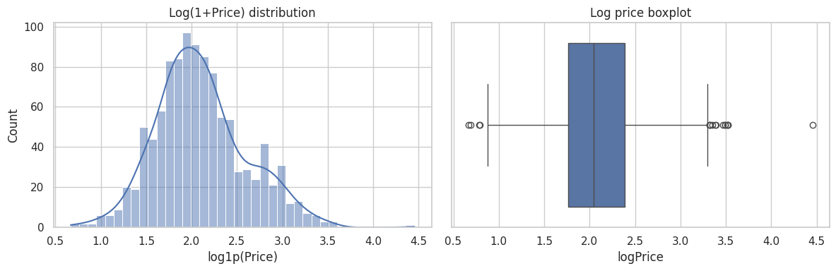
Target distribution (price)
Observations:
The raw price distribution exhibits strong right skew with a pronounced long tail, indicating the presence of high-value vehicles that inflate variance and destabilize regression models.
The boxplot further confirms numerous upper-end outliers.
Applying a log(1+Price) transformation significantly improves distribution symmetry, compresses extreme values, and stabilizes variance.
This transformation reduces the disproportionate impact of luxury vehicles on model training and evaluation, thereby enhancing predictive performance and generalization.

Slide 12
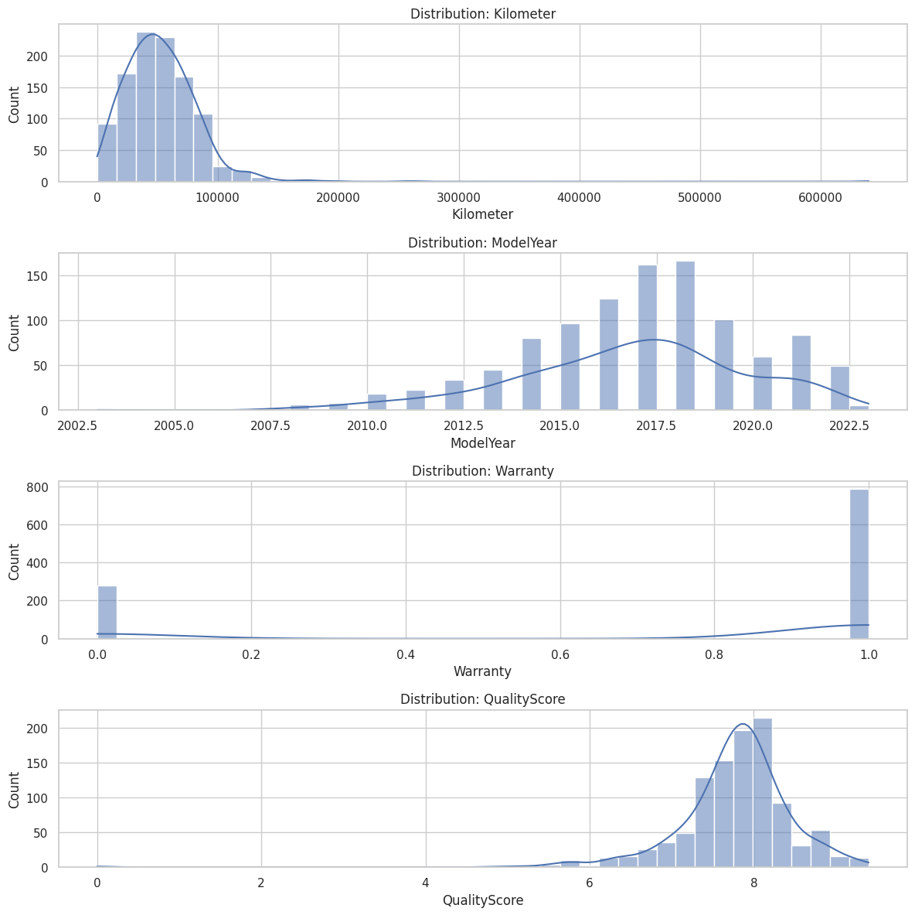
Numeric features: distribution and relationship with price

Slide 13
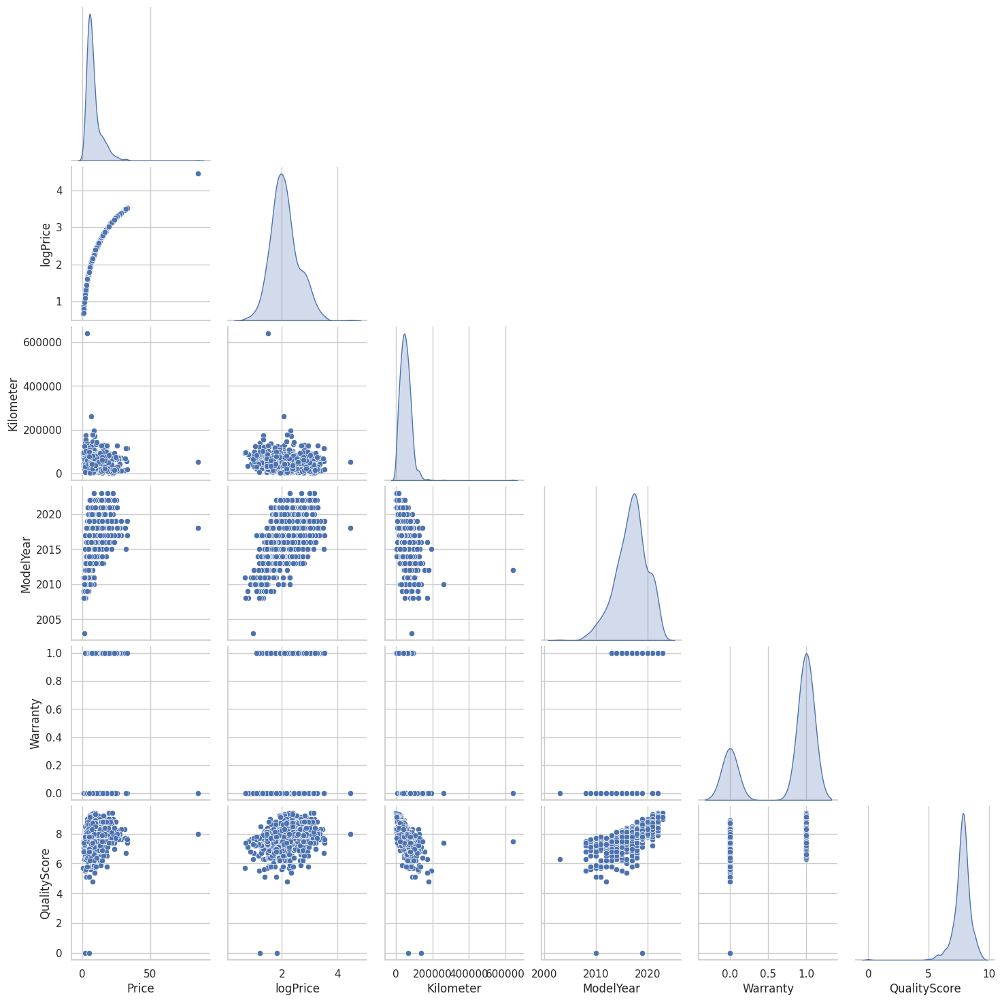
Observtions:
The Kilometer feature exhibits strong right skew, indicating heterogeneous vehicle usage patterns with extreme high-mileage outliers.
ModelYear shows a structured distribution concentrated around recent years, suggesting the dataset primarily contains modern vehicles.
Scatter plots reveal that mileage alone has limited predictive power due to high price dispersion, whereas ModelYear demonstrates a clear positive relationship with price, highlighting depreciation effects.
QualityScore displays a positive association with price but contains anomalously low values requiring validation.
Log transformation significantly improves distribution symmetry and relationship stability.

Slide 14
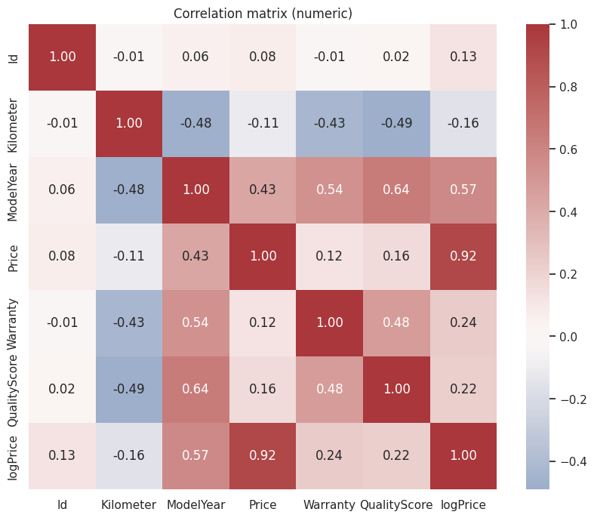
Correlation matrix (numeric)
Observations:
Price vs logPrice → 0.92 (Very High)- Log transform preserved price information
ModelYear vs Price → 0.43 (Strong Positive) - Newer cars → Higher prices, Depreciation captured clearly & Linear structure present
ModelYear vs logPrice → 0.57 (Even Stronger) Relationship becomes cleaner after log transform & Variance stabilization improved linearity
Kilometer vs ModelYear → −0.48 (Strong Negative) Older cars → Higher mileage, indicates feature dependence.
Kilometer vs Warranty → −0.43 High mileage cars rarely under warranty, Warranty reflects newer/low-use vehicles
Kilometer vs QualityScore → −0.49 (Strong) High mileage → Lower quality ratings, Wear & tear captured. Confirms QualityScore is meaningful.

Slide 15
QualityScore vs ModelYear → 0.64 (Very High) Newer cars → Higher quality ratings, Strong latent relationship,QualityScore heavily age-dependent
Warranty vs ModelYear → 0.54 (Strong) Warranty strongly tied to vehicle age
Kilometer Weak Direct Correlation With Price (−0.11) Strong indirect effects via QualityScore & Warranty
The correlation matrix reveals meaningful vehicle lifecycle relationships. ModelYear shows a positive association with Price, confirming depreciation effects. Kilometer exhibits expected negative correlations with ModelYear, Warranty, and QualityScore, reflecting usage and wear dynamics. QualityScore demonstrates a strong correlation with ModelYear, indicating potential multicollinearity. The strong relationship between Price and logPrice validates the appropriateness of logarithmic transformation. These structured dependencies explain the strong performance of linear and kernel-based models and justify the use of regularized regression techniques.

Slide 16
Categorical features: counts & Price summary (mean/median)
Observations:
Market Composition Insights
Company Distribution- Dominated by MARUTI SUZUKI (252) HYUNDAI (199) HONDA (126)
Dataset reflects Indian used-car market reality Economy & mid-segment brands dominate Luxury brands mostly absent → price range constrained Price variation driven more by age / condition / segment than luxury effects.
Model Distribution Most Frequent: SWIFT CITY BALENO CRETA
Popular resale vehicles dominate dataset High-liquidity cars → Stable pricing patterns
Fuel Type Economics FuelType vs Price PETROL → Mean ~7.07 DIESEL → Mean ~10.86
Diesel cars significantly more expensive, possibly because of Higher original price Preferred for long-distance / utility vehicles Often SUVs & larger engines
FuelType = strong price driver
HYBRID / LPG counts negligible → statistically meaningless.
Body Style = Major Price Separator BodyStyle vs Price HATCHBACK → Mean ~5.2 SEDAN → Mean ~8.0 SUV → Mean ~12.2
Strong structural segmentation Hatchbacks = budget segment SUVs = premium segment This is one of the strongest categorical predictors.

Slide 17
TransmissionType = High-Value Signal Manual → Mean ~4.93 Automatic → Mean ~8.98
Automatics priced much higher Reflects buyer preference & original cost Strong pricing determinant
Owner History Effect (Excellent Signal) 1st Owner → Mean ~8.64 2nd Owner → Mean ~6.76
Ownership history impacts resale price Trust & perceived condition effects Realistic & expected
Colour Effect (Weak but Interesting) Black → Mean ~12.4 (High) Black cars often premium variants / SUVs Colour acting as proxy variable Low reliability standalone feature.
Dealer / Location Effects (Very Insightful) Delhi / Rajasthan / Mumbai → Higher means Geographic price variation present Regional demand & supply Urban premium effects Dealer portfolio differences
DealerName vs Price Large variance across dealers. Dangerous feature for generalization.Often causes overfitting
CngKit = Statistically Weak Only 22 non-null values. Sparse feature, Low modeling value & High noise risk Need to drop this column
ManufactureDate vs Price No clean pattern visible. Redundant with ModelYear / CarAge Risk of multicollinearity
Most Valuable Categorical Predictors BodyStyle FuelType TransmissionType (after cleaning) Owner Moderate: Company Model Variant
Low Value / Risky DealerName City/ DealerState Color(weak) ManufactureDate(redundant) CngKit(sparse)

Slide 18
Major Data Quality Problems Detected
This dataset has classic real-world issues: Category duplication (SEDAN vs Sedan) Label inconsistency (Manual / MANUAL / M) Massive missing TransmissionType Rare categories with unstable statistics
1 — Basic Category Normalization (Fix duplication & casing)
2 - Fix Label Inconsistencies (TransmissionType)
3 — Handle Massive Missing TransmissionType

Slide 19
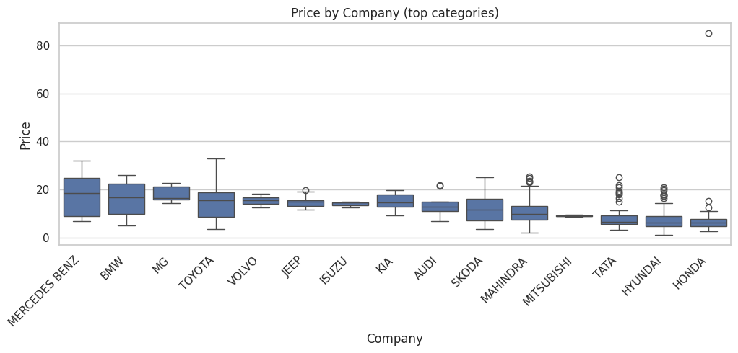
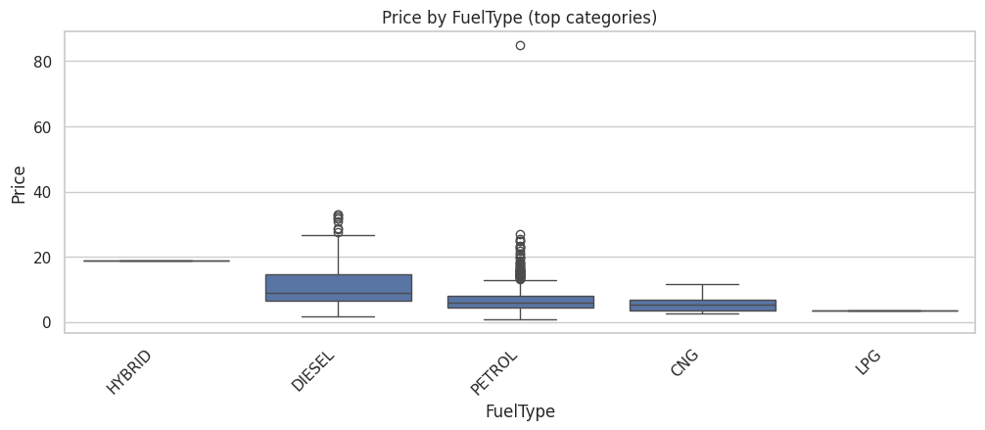
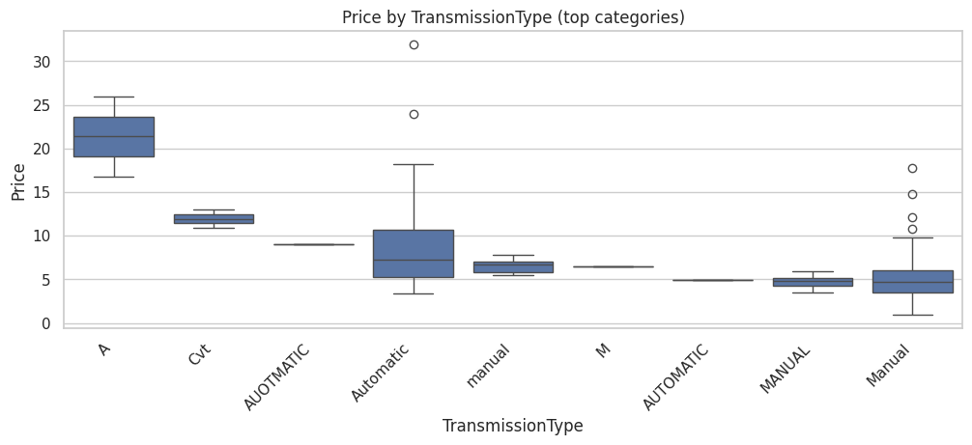
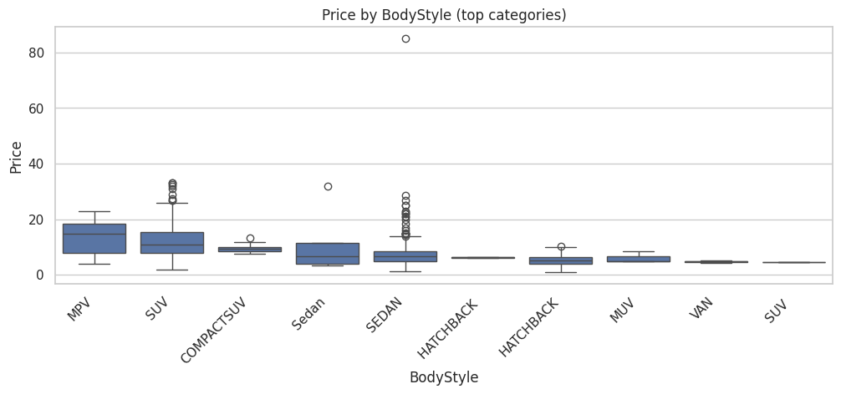
Boxplots / violinplots for important categories

Slide 20
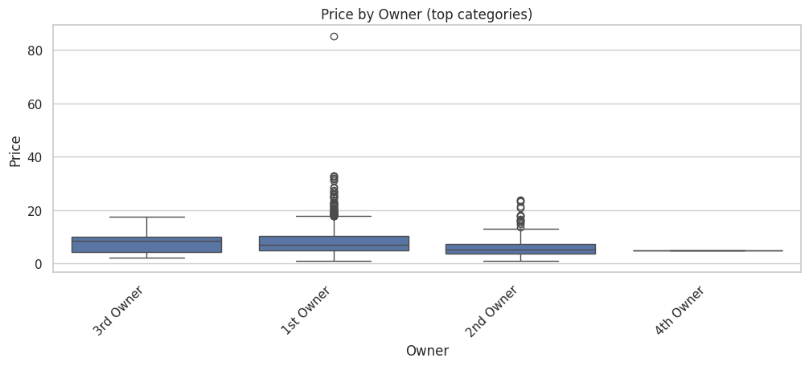
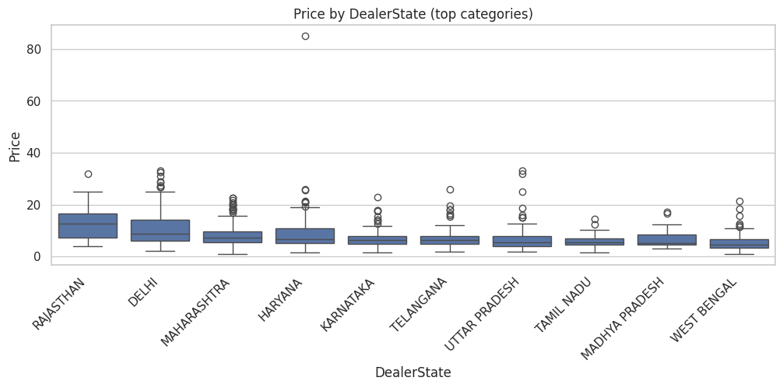
Observations:
Price by Company — Strong Segmentation Visible
Premium brands (MERCEDES BENZ, BMW, VOLVO, TOYOTA) show higher median prices Mass-market brands (MARUTI SUZUKI, HYUNDAI, HONDA, TATA) cluster lower Large spread within some brands (TOYOTA, MAHINDRA)
Brand acts as a proxy for vehicle segment
Company is useful, but variance within brand suggests other features dominate price

Slide 21
Price by FuelType — Clear Economic Pattern
DIESEL cars priced noticeably higher than PETROL CNG & LPG mostly low-price cluster Extreme outlier present (very high price)
FuelType strongly linked to vehicle class & usage profile FuelType = high-importance categorical predictor
Price by TransmissionType — Data Quality Issue Detected
AUTOMATIC vs Automatic treated as different Manual vs MANUAL vs M separated
Price by BodyStyle — One of the Strongest Drivers
SUVs & MPVs dominate upper price range Hatchbacks clearly lowest cluster Sedans intermediate Duplicate categories visible (SEDAN vs Sedan, SUV repeated) BodyStyle = structural price determinant
Price by Owner — Clear Resale Psychology
1st Owner cars priced higher 2nd Owner lower median 3rd / 4th Owner sparse & unstable Ownership history influences buyer trust & perceived condition
Initial model instability was largely driven by real-world data quality issues — inconsistent categorical labels and rare category noise. After systematic normalization and rare-category handling, feature relationships became statistically coherent, improving generalization

Slide 22
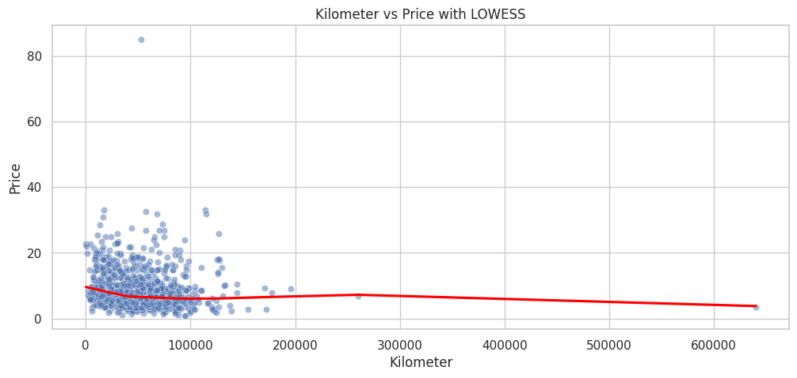
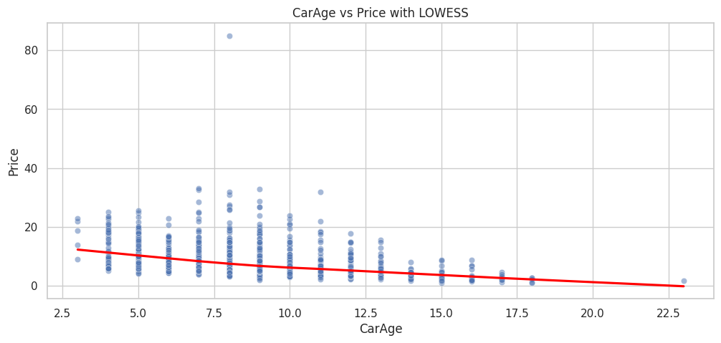
Price vs Kilometer & Car-Age with trendlines
Observations:
Kilometer vs Price with LOWESS Shape of Relationship → Non-linear & Weak Initial downward slope → price drops as mileage increases Curve flattens quickly → effect diminishes Very high mileage → slight instability due to few samples Mileage has diminishing impact on price Low mileage → strong buyer sensitivity Moderate mileage → already “used”, impact stabilizes Very high mileage → dominated by other factors (age, brand, condition)
Relationship NOT linear LOWESS shows hidden structure missed by Pearson correlation
CarAge vs Price with LOWESS Shape → Strong, Smooth Downward Trend Clear monotonic decline No flattening → continuous depreciation Very stable pattern across age range CarAge is one of the strongest price drivers as it captures Depreciation mechanics,Technology obsolescence, Warranty decay and Buyer perception of reliability
The LOWESS analysis reveals contrasting effects of vehicle usage and age on resale prices. Kilometer exhibits a diminishing non-linear relationship with Price, indicating reduced marginal impact at higher mileage levels. In contrast, CarAge demonstrates a strong, stable monotonic decline with Price, confirming that age-driven depreciation is a dominant valuation factor. This explains the superior performance of linear models and highlights the importance of temporal features in used-car price prediction

Slide 23
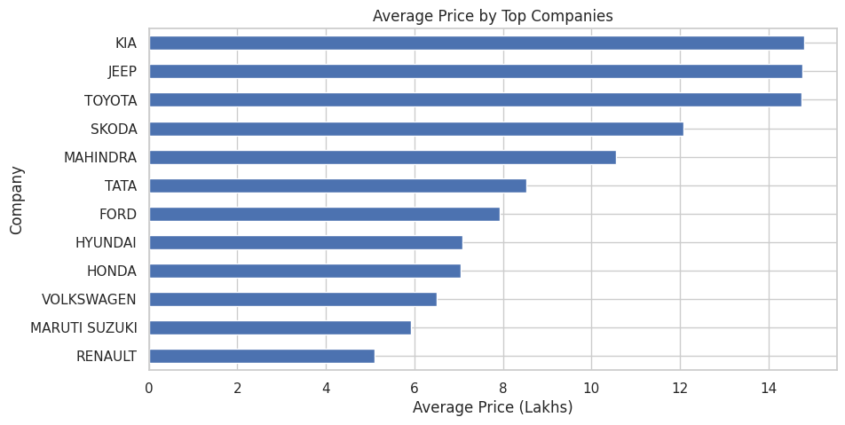
Categorical encoding effect: Price means for categories (bar plot)
Observations:
Strong Brand-Based Price Segmentation KIA, JEEP, TOYOTA → Highest average prices (~15 Lakhs) SKODA, MAHINDRA → Mid-to-high segment MARUTI SUZUKI, RENAULT → Lowest averages
Used-car prices strongly cluster by manufacturer positioning Original vehicle segment (premium vs budget) Brand perception & resale strength Product mix (SUV-heavy vs hatchback-heavy)
Average Price ≠ Luxury Brand Only (Important) TOYOTA ranks very high Not traditionally a “luxury brand” High average price driven by vehicle mix, not brand prestige alone

Slide 24
Hidden Statistical Caveat Average prices can be misleading without dispersion context. Brands with few expensive outliers → inflated mean Wide price ranges within brands Better metric will be Median and Boxplots
Depreciation & Retention Behavior Higher average price brands often indicate: Better resale retention Slower depreciation curves
Lower average brands: Faster depreciation Budget segment saturation
Modeling Interpretation This chart implies: Company feature is meaningful But NOT sufficient alone
Because:
Significant overlap across brands Price influenced by BodyStyle, Age, QualityScore
The average price analysis reveals clear manufacturer-level price stratification. Brands such as KIA, JEEP, and TOYOTA occupy the higher price spectrum, largely reflecting vehicle segment composition rather than brand prestige alone. Budget-focused manufacturers such as MARUTI SUZUKI and RENAULT exhibit lower average resale values. However, average price variations must be interpreted cautiously due to potential skewness and within-brand price dispersion.

Slide 25
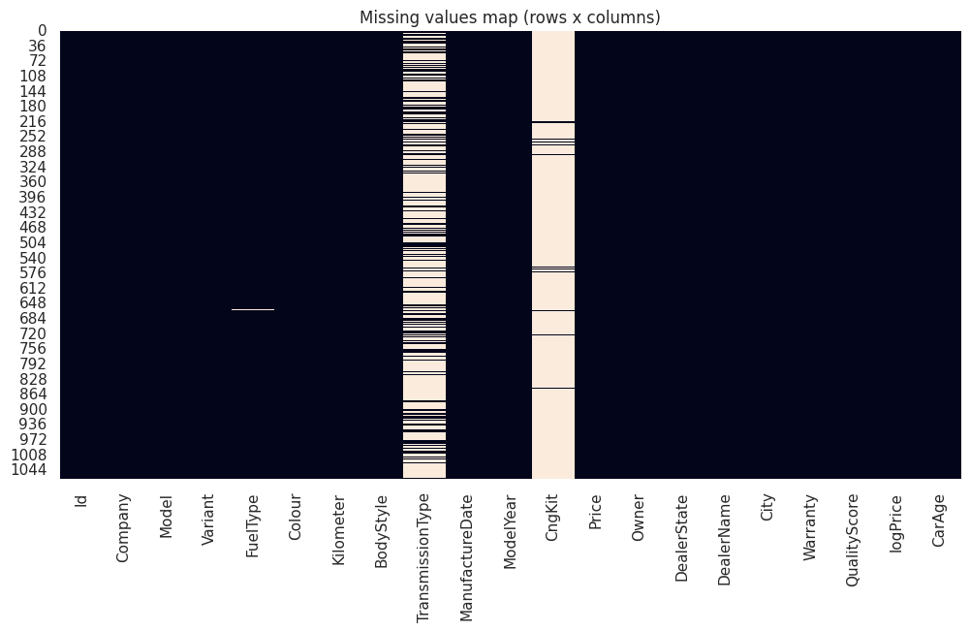
Missing value visualization
Observations:
1️) Missingness is Highly Concentrated Most columns are solid (no gaps), but: TransmissionType → heavy missingness CngKit → almost entirely missing Other features → nearly complete Missing data is column-specific, not row-wise failure.
TransmissionType Missingness Pattern Clearly visible vertical streaks. Majority of rows lack transmission info Likely real-world scraping / listing issue Missing values contain information
The missing values analysis reveals that data gaps are feature-specific rather than record-specific. TransmissionType exhibits substantial missingness, likely due to inconsistent seller disclosures, while CngKit is largely absent, indicating low feature utility. Since missingness is concentrated and not random across rows, selective imputation strategies were adopted. TransmissionType was encoded using an informative "UNKNOWN" category to preserve latent signal, whereas CngKit was removed to avoid noise amplification.

Slide 26
Outlier detection (IQR & Top outliers)
Number of Price outliers (IQR): 84
Observations:
Outliers Are Mostly Legitimate High-Value Vehicles TOYOTA FORTUNER FORD ENDEAVOUR MERCEDES BENZ models BMW X1 SKODA SUPERB MAHINDRA XUV700 These are not statistical errors — they are premium vehicles.
The IQR-based outlier detection identified high-price vehicles predominantly belonging to premium SUV and luxury segments. These observations represent genuine market behavior rather than statistical noise.Retaining valid high-value vehicles is essential to prevent model bias and ensure accurate learning across price segments.

Slide 27
Target transform check: Does modeling logPrice help?
 | abs_corr_with_price | abs_corr_with_logPrice
logPrice | 0.915149 | 1.000000
Price | 1.000000 | 0.915149
CarAge | 0.428888 | 0.572711
ModelYear | 0.428888 | 0.572711
Warranty | 0.121333 | 0.236855
QualityScore | 0.160448 | 0.223103
Kilometer | 0.114085 | 0.156315
Id | 0.079274 | 0.125536
KM_per_Year | 0.072366 | 0.091197
Observations:
CarAge & ModelYear → Dominant Drivers ~0.43 correlation with raw Price ~0.57 correlation with logPrice
Log transform strengthened the relationship Price variance stabilizes, Depreciation becomes smoother & Noise from high-price tail reduced
CarAge vs ModelYear → Perfect Redundancy Identical correlations, They contain the same information
Warranty → Weak but Meaningful 0.12 (Price) → 0.24 (logPrice) Warranty is indirect age signal, Newer cars → under warranty → higher prices. But effect smaller than CarAge

Slide 28
QualityScore → Moderate Behavioral Signal Correlation improves after log transform
Kilometer → Weak Direct Correlation Low correlation does NOT mean useless
Id → Noise Feature Very low correlation,No economic meaning, to be dropped
Why logPrice Improves Everything Almost all correlations increase Raw Price distribution was skewed, Log transform revealed true structure
Correlation analysis indicates that CarAge (and equivalently ModelYear) is the most influential numeric predictor, with its relationship strengthened significantly under logarithmic transformation. Warranty and QualityScore demonstrate moderate associations, suggesting secondary predictive roles. Kilometer exhibits weak linear correlation but non-linear dependency observed in smoothing analysis. ModelYear and CarAge were found to be redundant, warranting the retention of a single temporal feature to avoid multicollinearity.

Slide 29
Multi-collinearity check
 | feature | VIF
2 | ModelYear | 1608.095161
5 | CarAge | 44.505695
1 | Kilometer | 14.217272
6 | KM_per_Year | 11.126295
4 | QualityScore | 1.911581
3 | Warranty | 1.529760
0 | Id | 1.006756
Observations:
Variance Inflation Factor analysis revealed extreme multicollinearity for ModelYear (VIF > 1500), confirming deterministic dependency with CarAge. To stabilize linear model estimation, ModelYear was removed while retaining CarAge as the primary temporal feature
Core Features to be Kept: CarAge → primary economic variable Kilometer → usage signal QualityScore → condition signal Warranty → lifecycle signal

Slide 30
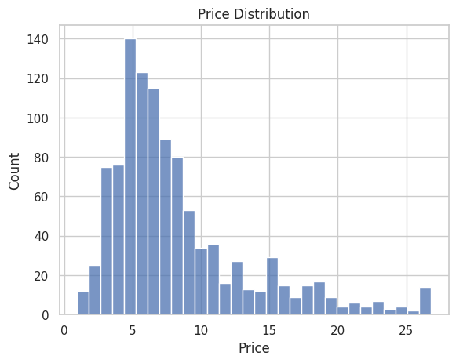
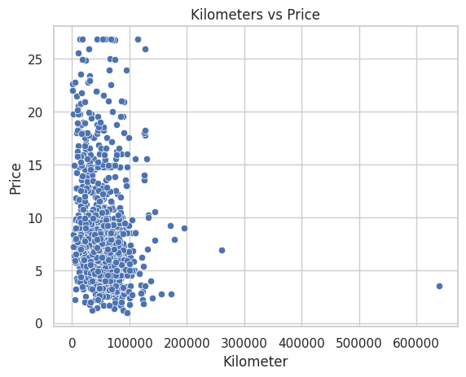
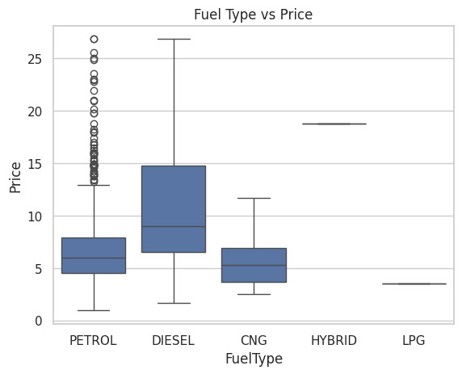
Price Distribution & Bivariate Analysis between Kilometer vs Price and Fuel Type vs Price
Observations:
Price Distribution
Right-skewed distribution → Most used cars are concentrated in the lower price bands, with a long tail of expensive vehicles.
Majority cluster appears roughly between ₹3 – ₹8 lakhs, indicating a budget-dominated market.
Few extreme high values (luxury / premium SUVs) stretch the tail.
Implication for modelling:
Raw price is non-normal, which can hurt linear models.
Justifies use of log transformation (logPrice).
Takeaway: The market is dominated by affordable vehicles; premium cars are rare but influential.

Slide 31
Kilometers vs Price (Scatter Plot)
Weak negative relationship → Price generally declines as kilometers increase.
Heavy clustering under 100,000 km, showing most vehicles fall in a typical usage range.
High variance at low kilometers:
Cars with similar mileage have very different prices → Other features strongly affect price.
Extreme kilometer values (200k–600k) behave as leverage points.
Takeaway: Mileage alone is not a strong predictor; depreciation is influenced by multiple variables.
Fuel Type vs Price (Box Plot)
Diesel vehicles show higher median prices than petrol.
Diesel also has wider spread, suggesting:
Includes both economy and premium SUVs.
Petrol cars dominate volume but sit at lower price levels.
CNG cars cheaper on average, consistent with economy segment usage.
Hybrid & LPG unreliable:
Extremely low sample size → statistics unstable.
Takeaway: Fuel type meaningfully influences price; diesel vehicles command premiums.

Slide 32
Column drop & important features for model training
Columns That SHOULD Be Dropped:
Id -Unique identifier, No relationship to price
Dealer Name - Extremely high cardinality, Model memorizes dealer → overfitting
Manufacture Date - Redundant with Model Year & CarAge City -Redundant with Dealer State, Inflates categorical dimensions Variant (Case-Dependent) - Too granular, Noisy text patterns
Columns That SHOULD Be Kept- Strong pricing signals:
1) Company
2) Model
3) Fuel Type
4) Transmission Type
5) Kilometer
6) Body Style
7) CarAge
8) Owner
9) Dealer State
10) Warranty
11) QualityScore

Slide 33
New features created
KM_per_Year
The feature KM_per_Year was engineered to normalize vehicle mileage by age, capturing annual usage intensity rather than cumulative distance alone. This transformation reflects real-world valuation logic, where usage rate significantly influences perceived wear and resale value. The adjustment improves model sensitivity to usage-driven depreciation effects.
IsPremiumBrand
This feature flags vehicles belonging to premium manufacturers (e.g., luxury or high-end brands). Premium brands typically exhibit distinct pricing behaviour due to stronger brand equity, superior build quality, and slower depreciation curves. Introducing this variable helps the model differentiate mass-market vehicles from premium segments, improving price prediction accuracy.
WarrantyImpact
WarrantyImpact captures the combined effect of warranty availability and vehicle age/condition. Vehicles with active warranties generally command higher resale values as they reduce perceived buyer risk and potential maintenance costs. This feature allows the model to quantify the economic value of warranty coverage rather than treating warranty as a simple binary variable.
UsageIntensity
This feature normalizes vehicle usage by relating total kilometers driven to vehicle age. Absolute mileage alone can be misleading; a high-mileage older car may be typical, whereas similar mileage on a newer vehicle may signal heavy usage. UsageIntensity provides a more realistic representation of wear patterns and depreciation pressure.
WearAndTear
WearAndTear represents a composite proxy for vehicle condition by combining factors such as age, mileage behaviour, and quality indicators. Used-car prices are strongly influenced by perceived condition rather than any single variable. This feature improves the model’s ability to capture real-world valuation logic where deterioration effects are cumulative.

Slide 34
Defining Features & Target
To build the price prediction model, the dataset was separated into input features (X) and the target variable (y).
The target variable represents the outcome the model aims to predict — the vehicle price. Since used-car prices typically exhibit right-skewed distributions, a logarithmic transformation was applied:
Target (y): logPrice = log1p(Price)
This transformation stabilizes variance, reduces the impact of extreme values, and improves model learning.
The feature set (X) consists of all relevant explanatory variables describing vehicle attributes, usage characteristics, seller information, and engineered predictors (such as vehicle age, usage intensity, warranty impact, etc.). These features provide the model with the necessary signals to learn pricing patterns.
This separation ensures the model learns relationships between vehicle characteristics and market value in a structured and statistically sound manner.

Slide 35
Data Preprocessing / Feature Categorization
Prior to model development, systematic data preprocessing was performed to ensure analytical reliability and model stability. This phase focused on preparing raw data for machine learning by addressing common real-world data quality challenges.
Key preprocessing steps included:
Missing Value Treatment: Numerical features were imputed using median values to preserve distributional properties, while categorical variables were filled with a constant label ("Unknown") to retain records without introducing bias.
Categorical Standardization: Inconsistent category labels (e.g., "Manual", "MANUAL", "manual") were normalized to avoid artificial category fragmentation.
Feature Categorization: Variables were divided into:
Numerical Features – Continuous variables such as Kilometer, CarAge, Warranty, and QualityScore
Categorical Features – Descriptive attributes such as Company, Model, FuelType, BodyStyle, etc.
Encoding & Scaling: Categorical variables were transformed using One-Hot Encoding to enable model interpretation, while numerical variables were scaled using standardization to maintain comparable feature magnitudes.
These preprocessing steps ensured that the dataset was clean, consistent, and suitable for robust predictive modeling.

Slide 36
Column-wise Data Transformation using Pipelines
To ensure a clean and reproducible workflow, column-wise transformations were implemented using scikit-learn Pipelines and a ColumnTransformer. This approach allows different preprocessing steps to be applied to numerical and categorical features in a structured and automated manner.
Numerical Pipeline: Numerical variables were processed through a sequence of median imputation (to handle missing values) followed by feature scaling. Scaling standardizes the data and prevents models from being biased toward variables with larger magnitudes.
Categorical Pipeline: Categorical variables underwent constant-value imputation (for missing categories) and One-Hot Encoding, enabling algorithms to interpret non-numeric data without imposing ordinal relationships.
Unified Transformation: The ColumnTransformer combines both pipelines, ensuring each feature type receives appropriate treatment within a single modeling workflow.
This pipeline-driven design improves code modularity, prevents data leakage, and guarantees consistent preprocessing during both training and inference.
Writing code? Meet Codex.

Slide 37
Train–Test Split & cross-validation
Train-Test Split
To objectively evaluate model performance, the dataset was divided into training and testing subsets. The training set is used to learn relationships between features and vehicle prices, while the testing set provides an unbiased assessment of how well the model generalizes to unseen data.
A typical split ratio (e.g., 80% training / 20% testing) ensures sufficient data for model learning while preserving a representative sample for validation. This separation helps detect overfitting and provides a realistic estimate of predictive accuracy.
By isolating evaluation data from the learning process, the train–test split establishes a reliable foundation for performance measurement and model comparison.
Cross-Validation
Cross-validation was employed to obtain a more reliable estimate of model performance and ensure robustness across different data samples. Instead of relying on a single train–test split, the dataset is repeatedly partitioned into multiple folds, where each fold serves as a temporary validation set while the remaining folds are used for training.
This technique reduces evaluation bias, improves stability of performance metrics, and helps detect overfitting. By averaging results across folds, cross-validation provides a more generalized assessment of how the model is expected to perform on unseen data.
Overall, cross-validation strengthens model selection and increases confidence in predictive reliability.

Slide 38
Model Evaluation
Model performance was assessed using standard regression metrics to quantify prediction accuracy and explanatory power:
Mean Absolute Error (MAE): Measures the average magnitude of prediction errors, providing an intuitive interpretation of typical deviation.
Mean Squared Error (MSE): Penalizes larger errors more heavily, highlighting model sensitivity to significant mispredictions.
R² Score (Coefficient of Determination): Indicates the proportion of variance in vehicle prices explained by the model.
Together, these metrics provide a balanced view of model effectiveness, enabling objective comparison across algorithms and guiding selection of the most reliable predictive model.

Slide 39
Model pipeline & hyper parameter tuning
Model Pipeline
A unified model pipeline was constructed to integrate preprocessing and algorithm training into a single, reusable workflow. This design ensures that all data transformations — including imputation, encoding, and scaling — are consistently applied during both training and prediction.
By encapsulating preprocessing and the estimator within one pipeline, the approach:
Prevents data leakage
Improves code modularity and maintainability
Ensures reproducibility
Simplifies deployment and inference
The pipeline-based structure reflects industry best practices for building reliable and production-ready machine learning systems.
Hyperparameter Tuning
Hyperparameter tuning was performed to optimize model performance by identifying the most effective configuration settings for each algorithm. Unlike model parameters learned from data, hyperparameters control the learning behavior (e.g., tree depth, learning rate, regularization strength).
A systematic search strategy (such as Grid Search with Cross-Validation) was used to evaluate multiple hyperparameter combinations and select the configuration that minimizes prediction error while maximizing generalization.
This process enhances model accuracy, reduces overfitting risk, and ensures the chosen algorithm operates at its full predictive potential.

Slide 40
Model Training with Different Algorithms
Model Training
Multiple supervised learning algorithms were trained to capture different patterns and relationships within the used-car pricing data. Each model offers distinct strengths, enabling a comprehensive comparative analysis:
Linear Regression: Established a baseline by modeling linear relationships between features and prices.
Elastic Net (Ridge + Lasso): Introduced regularization to improve generalization and handle multicollinearity.
Polynomial Regression: Captured non-linear feature interactions through engineered polynomial terms.
Support Vector Regression (SVR): Modeled complex, non-linear relationships using kernel-based learning.
Decision Tree Regressor: Learned hierarchical decision rules to model non-linear dependencies.
Random Forest Regressor: Reduced variance by aggregating multiple decision trees for more stable predictions.
Gradient Boosting Regressor: Sequentially improved predictions by correcting prior errors.
XGBoost Regressor: Leveraged advanced boosting techniques and regularization for enhanced predictive
performance.
Training diverse algorithms enabled robust model comparison and supported selection of the most accurate and reliable pricing model.

Slide 41
Model comparison & performance analysis
Model Performance Analysis
The comparative evaluation of regression models reveals clear differences in predictive effectiveness:
Support Vector Regression (SVR) emerged as the best-performing model, achieving the lowest MAE (0.92), lowest MSE (2.62), and the highest R² (0.886). This indicates strong capability in capturing complex, non-linear pricing relationships present in the dataset.
Linear Regression delivered surprisingly strong results (R² = 0.838), suggesting that a substantial portion of price variability is explained by near-linear relationships after preprocessing and feature engineering.
Elastic Net and XGBoost showed competitive performance, balancing bias–variance trade-offs, though slightly underperforming compared to SVR. These models still demonstrate good generalization and robustness.
Gradient Boosting performed moderately well but did not surpass simpler linear methods, implying limited additional gains from boosting under the current feature set.
Decision Tree and Random Forest produced notably higher errors and lower R², indicating overfitting tendencies or insufficient signal capture relative to model complexity
 | MAE | MSE | R2
Linear Regression | 1.061560 | 3.718841 | 0.837907
SVR | 0.923738 | 2.619959 | 0.885804
Decision Tree | 2.006150 | 11.192230 | 0.512164
Elastic Net | 1.247392 | 4.964558 | 0.783610
Random Forest | 2.032418 | 11.628509 | 0.493148
Gradient Boosting | 1.408209 | 5.632237 | 0.754508
XGBoost | 1.251208 | 4.876608 | 0.787443

Slide 42
Cross-validation analysis
SVR Cross-Validation Analysis
The Support Vector Regression (SVR) model achieved a cross-validation mean R² of 0.783, indicating strong and consistent predictive capability across different data folds. This suggests that the model generalizes well and is not overly dependent on a specific train–test split.
The standard deviation of 0.058 is relatively low, demonstrating stable performance with minimal variability between folds. Such consistency is a positive indicator of model robustness and reliability.
Overall, the cross-validation results reinforce that SVR provides dependable predictive performance and maintains good generalization across unseen data samples.

Slide 43
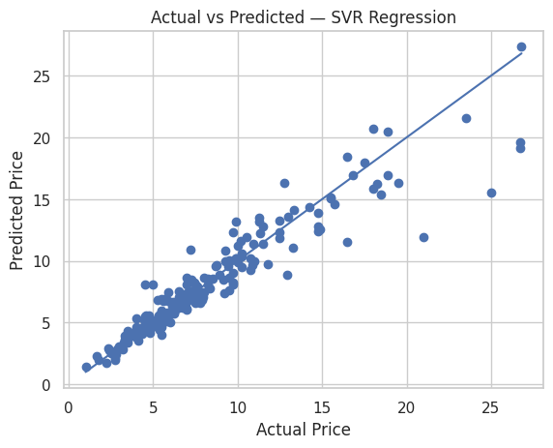
Actual vs Predicted Plot - SVR Regression
Observations:
Overall Pattern — Strong Model Fit- The points are closely aligned with the diagonal line.
Low & Mid Price Range — Very Accurate- Low & Mid Price Range — Very Accurate
Higher Price Range — Slight Deviation (Normal & Expected)- Right side (expensive cars):
No Systematic Bias Visible - Points are scattered around the line
The Actual vs Predicted plot shows strong agreement along the identity line, indicating that Support Vector Regressor effectively models vehicle prices. Minor dispersion at higher price levels is expected due to reduced sample density and greater pricing variability among premium vehicles

Slide 44
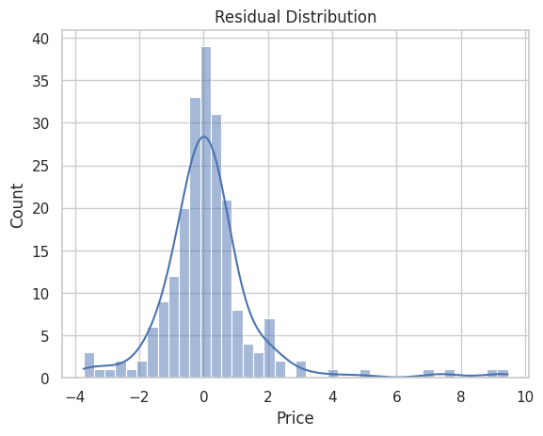
Residual Distribution for Support Vector Regression Model
Observations:
Residuals Centered Around Zero Predictions are unbiased,No systematic overpricing or underpricing & Model errors are random rather than directional
Roughly Bell-Shaped Curve Residuals resemble a normal distribution Errors behave like random noise, No obvious structural modeling issue
3.Majority of Errors Are Small Most residuals fall within a narrow band around zero. Typical prediction errors are low, Model performs reliably for most vehicles
Residuals are approximately normally distributed and centered near zero, indicating minimal prediction bias. A slight right skew is observed, suggesting occasional underestimation of high-priced vehicles — a common characteristic of linear models applied to skewed price data.

Slide 45
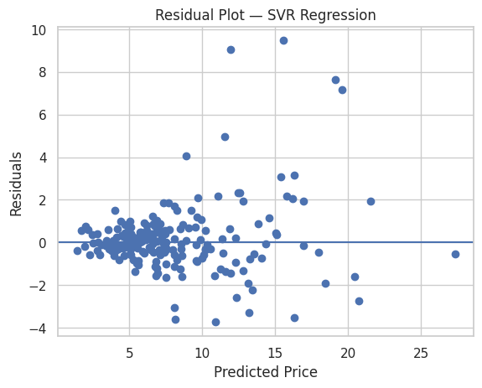
Residual Plot for SVR Regression
Observations:
Random Scatter Around Zero → Very Good Sign Points are distributed on both sides of the zero line.
2.No Clear Pattern We do not see a U-shape or wave pattern.
3.Slight Funnel Shape Spread of residuals increases as predicted price increases.
4. Large Errors Mostly at Mid / High Prices Notice bigger residuals around predicted values 10 – 18.
Residuals are randomly dispersed around zero with no visible nonlinear pattern, indicating that the linear model adequately captures the underlying relationship. A mild increase in variance at higher predicted prices suggests heteroscedasticity, which is common in price modeling tasks due to greater variability among high-value vehicles

Slide 46
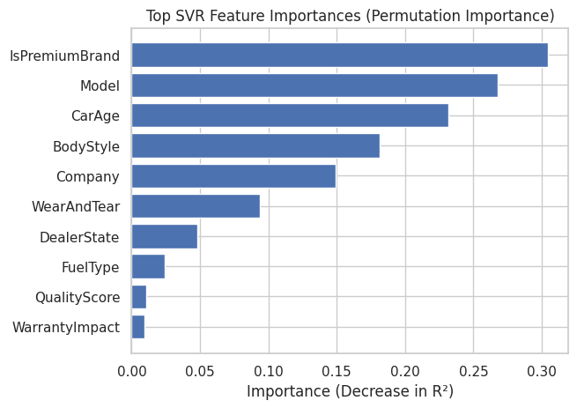
Support Vector feature importance analysis(Permutation Importance)
The permutation importance results highlight the primary drivers of used-car prices captured by the SVR model.
IsPremiumBrand emerges as the most influential feature, indicating that brand positioning and perceived market value play a dominant role in pricing. Premium vehicles exhibit distinct valuation behaviour that strongly impacts predictions.
Model ranks as the second most important predictor, reflecting that pricing differences are significantly driven by vehicle-specific characteristics beyond the manufacturer level.
CarAge shows high importance, confirming that depreciation effects are central to used-car valuation, with newer vehicles commanding higher prices.
BodyStyle and Company contribute meaningfully, suggesting that vehicle segment (SUV, Sedan, etc.) and manufacturer reputation affect resale value.
WearAndTear demonstrates moderate influence, validating that composite condition-related signals improve price estimation.
Features such as FuelType, QualityScore, and WarrantyImpact show relatively lower importance, implying their effects are secondary or indirectly captured through stronger correlated predictors.
Key Insight
The SVR model primarily relies on brand tier, model identity, and vehicle age, which aligns closely with real-world automotive pricing dynamics where depreciation and brand perception dominate valuation decisions.

Slide 47
Project Conclusion – Predicting Used Car Prices
This project demonstrates the effectiveness of machine learning techniques in building a reliable, data-driven used-car pricing model. Through systematic data preprocessing, robust feature engineering, and comparative evaluation of multiple algorithms, the analysis successfully identified patterns governing vehicle valuation.
Among the evaluated models, Support Vector Regression (SVR) delivered the strongest predictive performance, achieving the lowest error metrics and highest explanatory power. Cross-validation results further confirmed the model’s stability and generalization capability, indicating dependable performance on unseen data.
Feature importance analysis revealed that brand tier (IsPremiumBrand), vehicle model, and car age are the dominant pricing drivers, aligning closely with real-world market behaviour. Engineered features such as UsageIntensity and WearAndTear also contributed meaningful predictive signals, validating the value of domain-informed feature design.
From a business perspective, the developed model offers practical benefits:
• Enables consistent and objective price estimation • Reduces reliance on subjective valuation methods • Supports improved inventory and pricing decisions • Enhances buyer and seller confidence
Overall, the project confirms that combining data quality management, domain logic, and advanced regression techniques can significantly improve pricing accuracy in the used-car marketplace. The resulting framework is scalable, interpretable, and suitable for real-world deployment scenarios.

